Slide 1
Internet of Things
IoT Application Protocols
Professor: Dr.Siavash Khorsandi
Lecturer: Jaber Babaki
Amirkabir University of Technology
Fall 2020

Slide 2
Contents
Introduction
Physical and Link Layers Protocols (IoT Access Technologies)
Application Layer Protocols
Mostly adopted from Chapters 4, 5, and 6 of IoT Fundamentals: Networking Technologies, Protocols, and Use Cases for the Internet of Thing, Cisco press, 2017

Slide 3
Contents
Introduction
Physical and Link Layers Protocols (IoT Access Technologies)
Application Layer Protocols
IoT Application Transport Methods
Why Not Web Protocol for the Internet of Things?
Request-Response vs. Publish-Subscribe for Data Exchange Models?
IoT Application Protocols: MQTT and CoAP
Mostly adopted from Chapters 4, 5, and 6 of IoT Fundamentals: Networking Technologies, Protocols, and Use Cases for the Internet of Thing, Cisco press, 2017

Slide 4
IoT Application Transport Methods
The following categories of IoT application protocols and their transport methods are explored in the following sections:
Application layer protocol not present:
In this case, the data payload is directly transported on top of the lower layers.
No application layer protocol is used.
Generic web-based protocols:
Generic protocols, are found on many consumer- and enterprise-class IoT devices that communicate over non-constrained networks.
A web protocol like HTTP can also be used on small devices.
In the Arduino boards area, for example, there are many examples of smart sensors that have their own web server.
The user can direct his browser to the IP address of the device and receive data directly in the form of a web page
IoT application layer protocols:
IoT application layer protocols are devised to run on constrained nodes with a small compute footprint and are well adapted to the network bandwidth constraints on cellular or satellite links or constrained 6LoWPAN networks.
Message Queuing Telemetry Transport (MQTT) and Constrained Application Protocol (CoAP), covered later in this chapter, are two well-known examples of IoT application layer protocols.

Slide 5
Application Layer Protocol Not Present
As introduced before, IETF RFC 7228 devices defined as class 0 send or receive only a few bytes of data
For myriad reasons, such as processing capability, power constraints, and cost, these devices do not implement a fully structured network protocol stack, such as IP, TCP, or UDP, or even an application layer protocol.
Class 0 devices are usually simple smart objects that are severely constrained.
Implementing a robust protocol stack is usually not useful and sometimes not even possible with the limited available resources.
* IoT Fundamentals: Networking Technologies, Protocols, and Use Cases for the Internet of Thing, Cisco press, 2017

Slide 6
Application Layer Protocol Not Present
For example, consider low-cost temperature and relative humidity (RH) sensors sending data over an LPWA LoRaWAN infrastructure.
Temperature is represented as 2 bytes and RH as another 2 bytes of data. Therefore, this small data payload is directly transported on top of the LoRaWAN MAC layer, without the use of TCP/IP.
* IoT Fundamentals: Networking Technologies, Protocols, and Use Cases for the Internet of Thing, Cisco press, 2017

Slide 7
Application Layer Protocol Not Present
Following Example shows the raw data for temperature and relative humidity and how it can be decoded by the application.
* IoT Fundamentals: Networking Technologies, Protocols, and Use Cases for the Internet of Thing, Cisco press, 2017

Slide 8
Application Layer Protocol Not Present
While many constrained devices, such as sensors and actuators, have adopted deployments that have no application layer, this transportation method has not been standardized.
This lack of standardization makes it difficult for generic implementations of this transport method to be successful from an interoperability perspective.
* IoT Fundamentals: Networking Technologies, Protocols, and Use Cases for the Internet of Thing, Cisco press, 2017

Slide 9
Application Layer Protocol Not Present
Consider different kinds of temperature sensors from different manufacturers.
These sensors will report temperature data in varying formats.
A temperature value will always be present in the data transmitted by each sensor, but decoding this data will be vendor specific.
If you scale this scenario out across hundreds or thousands of sensors, the problem of allowing various applications to receive and interpret temperature values delivered in different formats becomes increasingly complex.
The solution to this problem is to use an IoT data broker, as detailed in Figure of next slide
An IoT data broker is a piece of middleware that standardizes sensor output into a common format that can then be retrieved by authorized applications.

Slide 10
Application Layer Protocol Not Present
IoT Data Broker
* IoT Fundamentals: Networking Technologies, Protocols, and Use Cases for the Internet of Thing, Cisco press, 2017

Slide 11
Application Layer Protocol Not Present
Directly transporting data payload without a structured network stack clearly optimizes data transmission over low-data-rate networks,
However, the lack of a data model implies that each application needs to know how to interpret the data-specific format.
This becomes increasingly complex for larger networks of devices with different data payload formats.
Furthermore, it makes the IoT application environment challenging in terms of evolution, development, interoperability, and so on, and often calls for structured data models and data broker applications.
* IoT Fundamentals: Networking Technologies, Protocols, and Use Cases for the Internet of Thing, Cisco press, 2017

Slide 12
Web Protocol for the Internet of Things
A web protocol like HTTP can also be used on small devices.
In the Arduino boards area, for example, there are many examples of smart sensors that have their own web server.
The user can direct his browser to the IP address of the device and receive data directly in the form of a web page.
Why don’t all small devices automatically become “web services”?
Application protocols for the Internet of Things, online available, https://www.wespeakiot.com/application-protocols-for-the-internet-of-things/

Slide 13
Web Protocol for the Internet of Things
Let’s take a closer look at the way HTTP works
The protocol is used to interact with web resources (e. g. web pages or forms) on a server.
Several methods are available for this purpose.
Most inquiries are made to request data (“GET”),
Other inquiries data can be transferred, e. g. when an order form has to be filled out in the online shop (method “POST”).
In principle, HTTP methods can also be used for interaction with devices:
Getting data from the device (“GET /temperature”), or
Control things/actuators (“POST /fan/control”).
Most developers are already familiar with HTTP web services. So, why not just have IoT devices connect to web services?
Application protocols for the Internet of Things, online available, https://www.wespeakiot.com/application-protocols-for-the-internet-of-things/

Slide 14
HTTP: Not necessarily suitable for small devices
There are several reasons why HTTP is not well suited to interacting with constrained devices:
HTTP is a heavy weight protocol with many headers and rules
HTTP would have a large header (up to several megabytes) which is not sensible for IoT usage with small packets
HTTP is a 1-1 protocol.
The client makes a request, and the server responds.
It is difficult and expensive to broadcast a message to all devices on the network, which is a common use case in IoT applications.
Application protocols for the Internet of Things, online available, https://www.wespeakiot.com/application-protocols-for-the-internet-of-things/

Slide 15
HTTP: Not Necessarily Suitable for Small Devices
HTTP is one-way.
The client must initiate the connection.
In an IoT application, the devices or sensors are typically clients; as a result, they cannot passively receive commands from the network.
HTTP is a 1-1 protocol.
The client makes a request, and the server responds.
It is difficult and expensive to broadcast a message to all devices on the network, which is a common use case in IoT applications.
Getting to know MQTT, online available, https://developer.ibm.com/articles/iot-mqtt-why-good-for-iot/

Slide 16
IoT Protocol Stack- Application Layer Protocols
Two of the most popular protocols are CoAP and MQTT.
Before introducing CoAP and MQTT, we review two data exchange models
Two Communication (Data Exchange) Models:
Request and Response
Publish and Subscribe
* IoT Fundamentals: Networking Technologies, Protocols, and Use Cases for the Internet of Thing, Cisco press, 2017

Slide 17
Request-Response vs. Publish-Subscribe
Request and Response Model
A client computer or software requests data or services, and a server computer or software responds to the request by providing the data or service
Examples:
Send a spreadsheet to the network printer
your spreadsheet program is the client and print server, responds to the request and allocates resources for printers on the network.
Watching the YouTube video on your smartphone
your web browser or YouTube app is the client, YouTube’s web server receives the request and responds by serving the video page to you
Request-response vs. publish-subscribe, part 1: What's the diff? , online available, https://blog.opto22.com/optoblog/request-response-vs-pub-sub-part-1
Notes:
For example, when you send a spreadsheet to the printer, your spreadsheet program is the client. Its request for printer services goes to your company’s print server, which responds to the request and allocates resources for printers on the network. The print server handles all the client requests for printing, making sure your spreadsheet and your coworkers’ print jobs are all completed in an orderly way.
When you want to watch that YouTube video on your smartphone, your web browser or YouTube app is the client, requesting the video over that giant of networks, the Internet. YouTube’s web server receives the request and responds by serving the video page to you, along with the other millions of video pages going to other millions of viewers worldwide.
In automation, the client is typically a PC, and the server is a PLC or PAC. The HMI application on your PC requests data from the PLC or PAC in order to display it on the monitor.
You can imagine request-response as a client sending an empty truck out to be filled with data. The server responds by putting the data on the truck and sending it back.

Slide 18
Request-Response vs. Publish-Subscribe
Publish and Subscribe
A central source called a broker (also sometimes called a server) which receives and distributes all data.
Pub-sub clients can publish data to the broker or subscribe to get data from it—or both.
Clients that publish data send it only when the data changes (report by exception, or RBE).
Clients that subscribe to data automatically receive it from the broker/server, but again, only when it changes.
The broker does not store data; it simply moves it from publishers to subscribers.
When data comes in from a publisher, the broker promptly sends it off to any client subscribed to that data.
Request-response vs. publish-subscribe, part 1: What's the diff? , online available, https://blog.opto22.com/optoblog/request-response-vs-pub-sub-part-1

Slide 19
Request-Response vs. Publish-Subscribe-Which to Use?
In a request-response architecture, each client opens a direct connection to each server, because the client requests data directly from the server.
In automation, as fast as multiple times per second—and servers repetitively respond:
Q: What’s the sensor value? A: 10 Q: What’s the sensor value? A: 10 Q: What’s the sensor value? A: 10 Q: What’s the sensor value? A: 10 Q: What’s the sensor value? A: 10 Q: What’s the sensor value? A: 9 Q: What’s the sensor value? A: 9
If your network is robust and has few servers, request-response model works very well.
As long as the server has the capacity to respond to client demands and the network can handle the volume of traffic, request-response is a proven, reliable communication method. It's particularly useful for communications over a secure internal network.
Request-response vs. publish-subscribe, part 2: Which to use?, online available, https://blog.opto22.com/optoblog/request-response-vs-pub-sub-part-2

Slide 20
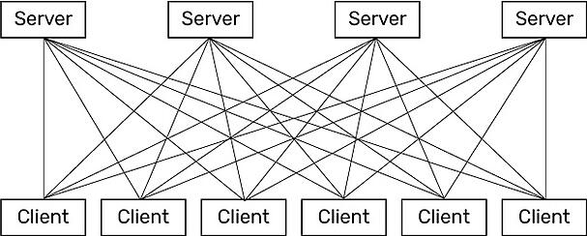
Request-Response vs. Publish-Subscribe-Which to Use?
What about traffic volume?
If you have multiple servers with multiple clients, however, the volume of traffic in a request-response model can quickly become a problem.
Request-response vs. publish-subscribe, part 2: Which to use?, online available, https://blog.opto22.com/optoblog/request-response-vs-pub-sub-part-2

Slide 21
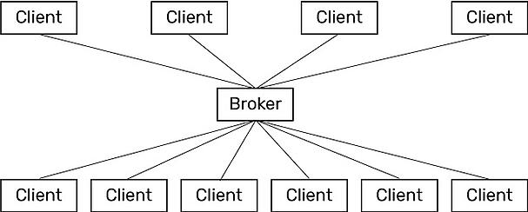
Request-Response vs. Publish-Subscribe-Which to Use?
In contrast, a pub-sub architecture simplifies communications.
Direct connections and repetitive requests for data are not needed.
The web of links is replaced by a single link from each device to the broker (also called a server).
The connection between client and broker is kept open and is incredibly lightweight.
Only two things travel over this connection: changed data, and a tiny heartbeat to let the broker know that the client is still there.
Pub-sub: good for heavy traffic and lightweight networks
Request-response vs. publish-subscribe, part 2: Which to use?, online available, https://blog.opto22.com/optoblog/request-response-vs-pub-sub-part-2

Slide 22
Request-Response vs. Publish-Subscribe-Which to Use?
So a pub-sub model can make sense if you have many servers and many clients that need to share data and services.
Since the broker is the central clearinghouse for data, individual servers don’t have to strain to serve multiple clients, and clients don’t have to connect to multiple servers.
In addition, network traffic is reduced overall, because data is published and sent on a report-by-exception (RBE) basis.
that is, only when the data changes—rather than at regular intervals.
Pub-sub can also make sense when it's difficult to set up a direct connection between a client and a server, or when the network is low-bandwidth, expensive, or unreliable—for example, when monitoring equipment in remote locations.
Request-response vs. publish-subscribe, part 2: Which to use?, online available, https://blog.opto22.com/optoblog/request-response-vs-pub-sub-part-2

Slide 23
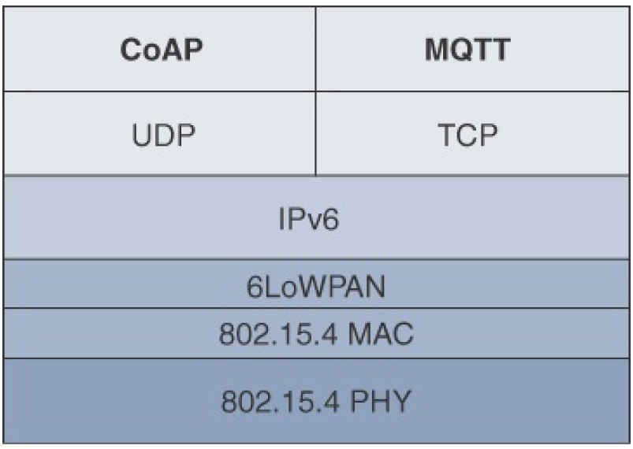
IoT Application Layer Protocols
Constrained Application Protocol (CoAP)
Uses both client-server and pub-Sub methods
UDP-based
Message Queuing Telemetry Transport (MQTT)
Based on pub-sub
TCP-based

Slide 24
IoT Application Layer Protocols-CoAP
CoAP has been created close to HTTP in several aspects:
It is basically a request/response protocol,
It integrates the URIs known from the web world to name resources.
It also adopts some of the query methods (such as “GET”,”PUT”,”POST”, etc.) and defines response codes similar to those of HTTP (e. g. 4.04 “Not found” if a resource could not be found).
Web developers who have grown up with HTTP can quickly find their way around CoAP.
Application protocols for the Internet of Things, online available, https://www.wespeakiot.com/application-protocols-for-the-internet-of-things/

Slide 25
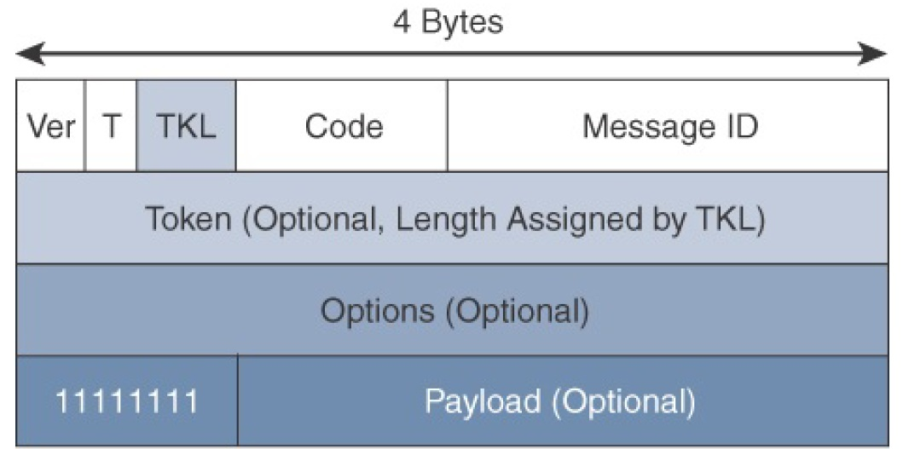
IoT Protocol Stack- Application Layer Protocols
Application Layer Protocols- CoAP
The CoAP framework defines simple and flexible ways to manipulate sensors and actuators for data or device management
A CoAP message is composed of
a short fixed length Header field (4 bytes),
a variable-length but mandatory Token field
(0–8 bytes),
Options fields if necessary, and the Payload field
* IoT Fundamentals: Networking Technologies, Protocols, and Use Cases for the Internet of Thing, Cisco press, 2017
Notes:
CoAP can run over IPv4 or IPv6. However, it is recommended that the message fit within a single IP packet and UDP payload to avoid fragmentation. For IPv6, with the default MTU size being 1280 bytes and allowing for no fragmentation across nodes, the maximum CoAP message size could be up to 1152 bytes, including 1024 bytes for the payload. In the case of IPv4, as IP fragmentation may exist across the network, implementations should limit themselves to more conservative values and set the IPv4 Don’t Fragment (DF) bit.
While most sensor and actuator traffic utilizes small-packet payloads, some use cases, such as firmware upgrades, require the capability to send larger payloads. CoAP doesn’t rely on IP fragmentation but defines (in RFC 7959) a pair of Block options for transferring multiple blocks of information from a resource representation in multiple request/response pairs.

Slide 26
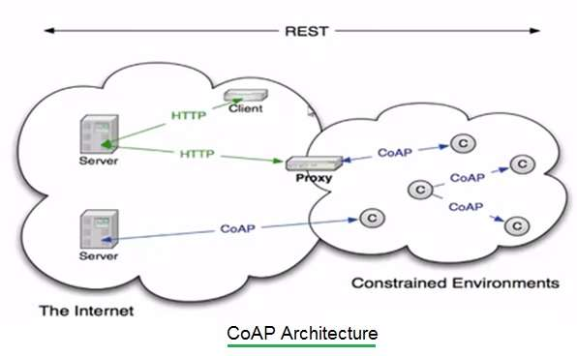
IoT Application Layer Protocols-CoAP
Application Layer Protocols- CoAP
CoAP Architectur
Connections can be between devices located on the same or different constrained networks or between devices and generic Internet or cloud servers, all operating over IP.
* https://www.rfwireless-world.com/Terminology/Difference-between-CoAP-and-HTTP.html

Slide 27
IoT Application Layer Protocols-CoAP
Through the exchange of asynchronous messages, a client requests an action via a method code on a server resource.
A uniform resource identifier (URI) localized on the server identifies this resource.
The server responds with a response code that may include a resource representation.
The CoAP request/response semantics include the methods GET, POST, PUT, and DELETE.
* IoT Fundamentals: Networking Technologies, Protocols, and Use Cases for the Internet of Thing, Cisco press, 2017
Notes:
CoAP defines four types of messages: confirmable, non-confirmable, acknowledgement, and reset. Method codes and response codes included in some of these messages make them carry requests or responses. CoAP code, method and response codes, option numbers, and content format have been assigned by IANA as Constrained RESTful Environments (CoRE) parameters.
A message that does not require reliable transmission (for example, each single measurement out of a stream of sensor data) can be sent as a Non-confirmable message (NON). These are not acknowledged, but still have a Message ID for duplicate detection (in this example, 0x01a0); see Figure 3. When a recipient is not able to process a Non-confirmable message, it may reply with a Reset message (RST).

Slide 28
IoT Application Layer Protocols-CoAP
CoAP Messages Type
Confirmable
a reliable transmission of messages on UDP protocol
basic congestion control with a default time-out
simple stop and wait retransmission with exponential back-off mechanism
detection of duplicate messages through a message ID
while running over UDP, CoAP offers a reliable transmission of messages when a CoAP header is marked as “confirmable.”
Non-Confirmable
not require reliable transmission
* IoT Fundamentals: Networking Technologies, Protocols, and Use Cases for the Internet of Thing, Cisco press, 2017
Notes:
CoAP defines four types of messages: confirmable, non-confirmable, acknowledgement, and reset. Method codes and response codes included in some of these messages make them carry requests or responses. CoAP code, method and response codes, option numbers, and content format have been assigned by IANA as Constrained RESTful Environments (CoRE) parameters.
A message that does not require reliable transmission (for example, each single measurement out of a stream of sensor data) can be sent as a Non-confirmable message (NON). These are not acknowledged, but still have a Message ID for duplicate detection (in this example, 0x01a0); see Figure 3. When a recipient is not able to process a Non-confirmable message, it may reply with a Reset message (RST).

Slide 29
IoT Application Layer Protocols-CoAP
CoAP Messages Type
Acknowledgement
the recipient must explicitly either acknowledge or reject the confirmable message using the same message ID
Reset
a recipient sends a reset message when can’t process a confirmable or non-confirmable message
* IoT Fundamentals: Networking Technologies, Protocols, and Use Cases for the Internet of Thing, Cisco press, 2017
Notes:
CoAP defines four types of messages: confirmable, non-confirmable, acknowledgement, and reset. Method codes and response codes included in some of these messages make them carry requests or responses. CoAP code, method and response codes, option numbers, and content format have been assigned by IANA as Constrained RESTful Environments (CoRE) parameters.
A message that does not require reliable transmission (for example, each single measurement out of a stream of sensor data) can be sent as a Non-confirmable message (NON). These are not acknowledged, but still have a Message ID for duplicate detection (in this example, 0x01a0); see Figure 3. When a recipient is not able to process a Non-confirmable message, it may reply with a Reset message (RST).

Slide 30
IoT Application Layer Protocols-CoAP
CoAP Messages semantics
Get
Post
Put
Delete
Method codes and response codes included in some of these four-types messages make them carry requests or responses
* IoT Fundamentals: Networking Technologies, Protocols, and Use Cases for the Internet of Thing, Cisco press, 2017
Notes:
From RFC-7252
GET
The GET method retrieves a representation for the information that currently corresponds to the resource identified by the request URI. If the request includes an Accept Option, that indicates the preferred content-format of a response. If the request includes an ETag Option, the GET method requests that ETag be validated and that the representation be transferred only if validation failed. Upon success, a 2.05 (Content) or 2.03 (Valid) Response Code SHOULD be present in the response. The GET method is safe and idempotent.
POST
The POST method requests that the representation enclosed in the request be processed. The actual function performed by the POST method is determined by the origin server and dependent on the target resource. It usually results in a new resource being created or the target resource being updated. If a resource has been created on the server, the response returned by the server SHOULD have a 2.01 (Created) Response Code and SHOULD include the URI of the new resource in a sequence of one or more Location-Path and/or Location-Query Options . If the POST succeeds but does not result in a new resource being created on the server, the response SHOULD have a 2.04 (Changed) Response Code. If the POST succeeds and results in the target resource being deleted, the response SHOULD have a 2.02 (Deleted) Response Code. POST is neither safe nor idempotent.
PUT
The PUT method requests that the resource identified by the request URI be updated or created with the enclosed representation. The representation format is specified by the media type and content coding given in the Content-Format Option, if provided. If a resource exists at the request URI, the enclosed representation SHOULD be considered a modified version of that resource, and a 2.04 (Changed) Response Code SHOULD be returned. If no resource exists, then the server MAY create a new resource with that URI, resulting in a 2.01 (Created) Response Code. If the resource could not be created or modified, then an appropriate error Response Code SHOULD be sent. Further restrictions to a PUT can be made by including the If-Match or If-None-Match options in the request. PUT is not safe but is idempotent.
DELETE
The DELETE method requests that the resource identified by the request URI be deleted. A 2.02 (Deleted) Response Code SHOULD be used on success or in case the resource did not exist before the request. DELETE is not safe but is idempotent.

Slide 31
IoT Application Layer Protocols-CoAP
* IoT Fundamentals: Networking Technologies, Protocols, and Use Cases for the Internet of Thing, Cisco press, 2017
Notes:
Figure 6-9 shows a utility operations center on the left, acting as the CoAP
client, with the CoAP server being a temperature sensor on the right of the
figure. The communication between the client and server uses a CoAP
message ID of 0x47. The CoAP Message ID ensures reliability and is used to
detect duplicate messages.
The client in Figure 6-9 sends a GET message to get the temperature from the
sensor. Notice that the 0x47 message ID is present for this GET message and
that the message is also marked with CON. A CON, or confirmable, marking
in a CoAP message means the message will be retransmitted until the
recipient sends an acknowledgement (or ACK) with the same message ID.
In Figure 6-9, the temperature sensor does reply with an ACK message referencing the correct message ID of 0x47. In addition, this ACK message
piggybacks a successful response to the GET request itself. This is indicated
by the 2.05 response code followed by the requested data.

Slide 32
IoT Application Layer Protocols-CoAP
CoAP vs HTTP
CoAP is upgraded version of HTTP.
It is designed for resource constrained applications such as IoT/WSN/M2M etc.
CoAP is based on UDP.
It uses ACK messages so that it will become reliable like TCP.
CoAP has low latency and consumes lesser power compare to HTTP.
* https://www.rfwireless-world.com/Terminology/Difference-between-CoAP-and-HTTP.html

Slide 33
IoT Application Layer Protocols-CoAP
CoAP vs HTTP
Differences of CoAP with HTTP result mainly in the amount of data used.
In contrast to the plain text format of HTTP, especially the header format, CoAP code words are packed in bytes or individual bits of a binary representation.
There are messages that require a response (“Confirmable”), and messages that do not need a response (“Non-Confirmable”).
This means that the information about the reliability of a transmission is lifted to the application layer and can be distinguished by the application in individual cases.
Application protocols for the Internet of Things, online available, https://www.wespeakiot.com/application-protocols-for-the-internet-of-things/

Slide 34
IoT Application Layer Protocols-CoAP
For example:
If a temperature sensor transmits the temperature 1x per minute, a failure of a single message can be merged, it could be mapped as a non-confirmable.
If a smart door lock is supposed to lock the door, the message behind it is surely to be classified as “Confirmable”.
Application protocols for the Internet of Things, online available, https://www.wespeakiot.com/application-protocols-for-the-internet-of-things/

Slide 35
IoT Application Layer Protocols-CoAP
CoAP vs HTTP
The asynchronicity of message exchange via UDP also gives CoAP a device the possibility of responding to a request in a resource-saving and time-delayed manner, as well as of transmitting a response in several small (partly “smallest”) blocks.
The latter is particularly useful for lossy networks with small packet sizes such as those in the WPAN and LPWAN.
Application protocols for the Internet of Things, online available, https://www.wespeakiot.com/application-protocols-for-the-internet-of-things/

Slide 36
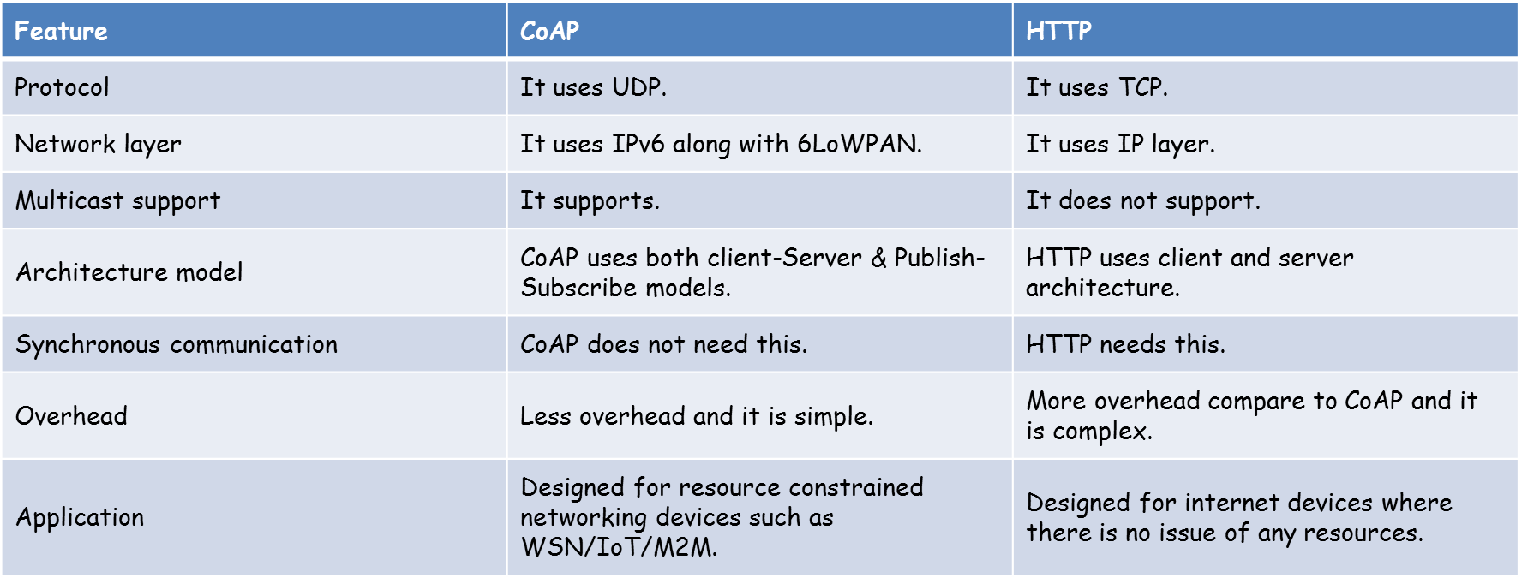
IoT Application Layer Protocols-CoAP
CoAP vs HTTP
* https://www.rfwireless-world.com/Terminology/Difference-between-CoAP-and-HTTP.html

Slide 37
IoT Application Layer Protocols-MQTT
At the end of the 1990s, engineers from IBM and Arcom (acquired in 2006 by Eurotech) were looking for a reliable, lightweight, and cost-effective protocol to monitor and control a large number of sensors and their data from a central server location, as typically used by the oil and gas industries.
Their research resulted in the development and implementation of the Message Queuing Telemetry Transport (MQTT) protocol that is now standardized by the Organization for the Advancement of Structured Information Standards (OASIS).

Slide 38
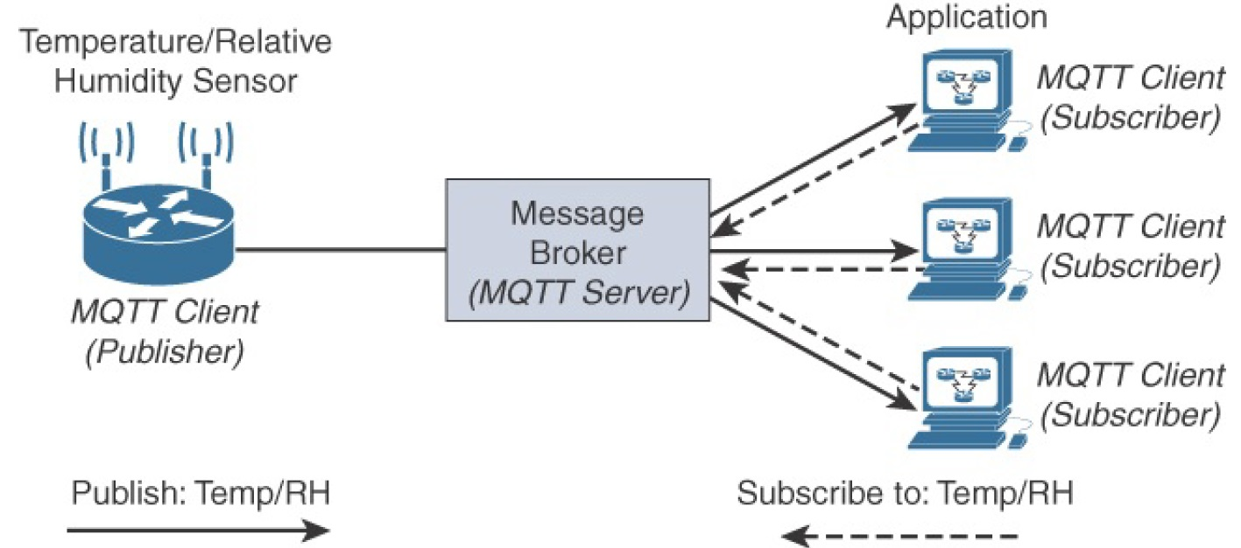
IoT Application Layer Protocols-MQTT
Application Layer Protocols- MQTT
MQTT Publish/Subscribe Framework
Is like Twitter
* IoT Fundamentals: Networking Technologies, Protocols, and Use Cases for the Internet of Thing, Cisco press, 2017
Notes:
An MQTT client can act as a publisher to send data (or resource information) to an MQTT server acting as an MQTT message broker. In Figure, the MQTT client on the left side is a temperature (Temp) and relative humidity (RH) sensor that publishes its Temp/RH data.
The MQTT server (or message broker) accepts the network connection along with application messages, such as Temp/RH data, from the publishers. It also handles the subscription and unsubscription process and pushes the application data to MQTT clients acting as subscribers.
The application on the right side of Figure is an MQTT client that is a subscriber to the Temp/RH data being generated by the publisher or sensor on the left. This model, where subscribers express a desire to receive information from publishers, is well known.
With MQTT, clients can subscribe to all data (using a wildcard character) or specific data from the information tree of a publisher. In addition, the presence of a message broker in MQTT decouples the data transmission between clients acting as publishers and subscribers. In fact, publishers and subscribers do not even know (or need to know) about each other. A benefit of having this decoupling is that the MQTT message broker ensures that information can be buffered and cached in case of network failures. This also means that publishers and subscribers do not have to be online at the same time.
MQTT control packets run over a TCP transport using port 1883. TCP ensures an ordered, lossless stream of bytes between the MQTT client and the MQTT server. Optionally, MQTT can be secured using TLS on port 8883, and WebSocket (defined in RFC 6455) can also be used.

Slide 39
IoT Application Layer Protocols-MQTT
With MQTT, clients can subscribe to all data (using a wildcard character) or specific data from the information tree of a publisher.
In addition, the presence of a message broker in MQTT decouples the data transmission between clients acting as publishers and subscribers.
In fact, publishers and subscribers do not even know (or need to know) about each other.
A benefit of having this decoupling is that the MQTT message broker ensures that information can be buffered and cached in case of network failures.
This also means that publishers and subscribers do not have to be online at the same time.
* IoT Fundamentals: Networking Technologies, Protocols, and Use Cases for the Internet of Thing, Cisco press, 2017

Slide 40
IoT Application Layer Protocols-MQTT
MQTT is extremely lightweight
it takes up almost no space in a device, so that even small devices with very little computing power can use it.
Each control packet consists of a 2-byte fixed header with optional variable header fields and optional payload.
Note that a control packet can contain a payload up to 256 MB.
Request-response vs. publish-subscribe, part 1: What's the diff? , online available, https://blog.opto22.com/optoblog/request-response-vs-pub-sub-part-1

Slide 41
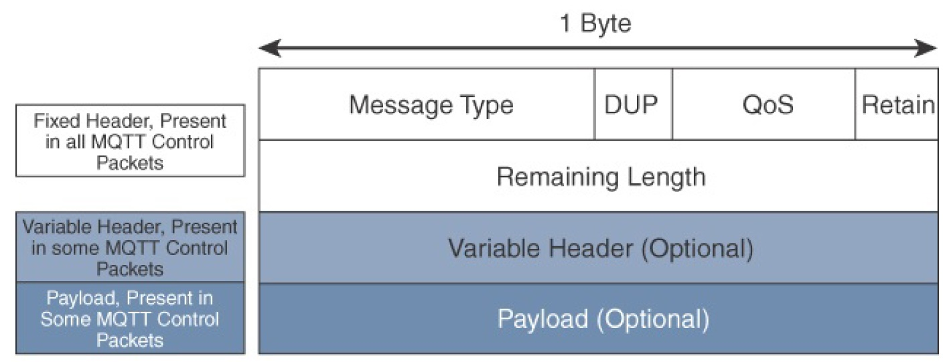
IoT Application Layer Protocols-MQTT
MQTT Message Format
Compared to the CoAP message format, MQTT contains a smaller header of 2 bytes compared to 4 bytes for CoAP
* IoT Fundamentals: Networking Technologies, Protocols, and Use Cases for the Internet of Thing, Cisco press, 2017
Notes:
The next field in the MQTT header is DUP (Duplication Flag). This flag,
when set, allows the client to notate that the packet has been sent previously,
but an acknowledgement was not received.
The QoS header field allows for the selection of three different QoS levels.
These are discussed in more detail later in this chapter.
The next field is the Retain flag. Only found in a PUBLISH message (refer to
Table 6-2), the Retain flag notifies the server to hold onto the message data.
This allows new subscribers to instantly receive the last known value without
having to wait for the next update from the publisher.

Slide 42
IoT Application Layer Protocols-MQTT
Message Type
identifies the kind of MQTT packet within a message
Fourteen different types of control packets are specified in MQTT version 3.1.1.
Each of them has a unique value that is coded into the Message Type field.
* IoT Fundamentals: Networking Technologies, Protocols, and Use Cases for the Internet of Thing, Cisco press, 2017
Notes:
The next field in the MQTT header is DUP (Duplication Flag). This flag,
when set, allows the client to notate that the packet has been sent previously,
but an acknowledgement was not received.
The QoS header field allows for the selection of three different QoS levels.
These are discussed in more detail later in this chapter.
The next field is the Retain flag. Only found in a PUBLISH message (refer to
Table 6-2), the Retain flag notifies the server to hold onto the message data.
This allows new subscribers to instantly receive the last known value without
having to wait for the next update from the publisher.

Slide 43
IoT Application Layer Protocols-MQTT
DUP (Duplication Flag) field:
This flag, when set, allows the client to notate that the packet has been sent previously, but an acknowledgement was not received.
The QoS header field:
allows for the selection of three different QoS levels.
Retain flag field:
Only found in a PUBLISH message, the Retain flag notifies the server to hold onto the message data.
This allows new subscribers to instantly receive the last known value without having to wait for the next update from the publisher.
* IoT Fundamentals: Networking Technologies, Protocols, and Use Cases for the Internet of Thing, Cisco press, 2017

Slide 44
IoT Application Layer Protocols-MQTT
The MQTT protocol defines two types of entities in the network:
a message broker
a number of clients.
The broker is a server that receives all messages from the clients and then routes those messages to relevant destination clients.
A client is anything that can interact with the broker to send and receive messages.
A client could be an IoT sensor in the field or an application in a data center that processes IoT data.
Both publishers and subscribers are called as clients
Getting to know MQTT, online available, developer.ibm.com/articles/iot-mqtt-why-good-for-iot/+&cd=10&hl=en&ct=clnk&gl=ir

Slide 45
IoT Application Layer Protocols-Terminology of MQTT
Client:
Clients can be persistent or transient.
Persistent clients maintain a session with the broker
transient clients are not tracked by the broker.
Clients often connect to the broker through libraries and SDKs.
There are over a dozen libraries available for C, C++, Go, Java, C#, PHP, Python, Node.js, and Arduino.
Get to Know MQTT: The Messaging Protocol for the Internet of Things, online available, https://thenewstack.io/mqtt-protocol-iot/

Slide 46
IoT Application Layer Protocols-Terminology of MQTT
Broker
The broker is the software that receives all the messages from the publishing clients and sends them to the subscribing clients.
It holds the connection to persistent clients.
Since the broker can become the bottleneck or result in a single point of failure, it is often clustered for scalability and reliability.
It is up to the implementers to decide how to create a scalable broker layer.
MQTT brokers include
Commercial: HiveMQ, Xively, AWS IoT, and Loop,
an open source: Mosquitto.
Get to Know MQTT: The Messaging Protocol for the Internet of Things, online available, https://thenewstack.io/mqtt-protocol-iot/

Slide 47
IoT Application Layer Protocols-Terminology of MQTT
Topic
A topic in MQTT is an endpoint to that the clients connect.
It acts as the central distribution hub for publishing and subscribing messages.
A topic is a well-known location for the publisher and subscriber.
Topics are simple, hierarchical strings, delimited by a forward slash.
For example, building1/room1/temperature and building1/room1/humidity are valid topic names. Subscribers can choose to subscribe to a specific topic or all the subtopics through wildcards.
A subscription to building1/+/temperature will automatically subscribe to the temperature topic of all the rooms in the building.
Similarly, building1/#/ will match all the topics available under building1. Refer to the MQTT specification for more details on the wildcards.
Get to Know MQTT: The Messaging Protocol for the Internet of Things, online available, https://thenewstack.io/mqtt-protocol-iot/

Slide 48
IoT Application Layer Protocols
MQTT vs HTTP
MQTT is data centric whereas HTTP is document-centric.
HTTP is request-response protocol for client-server computing and not always optimized for mobile devices. Whereas MQTT is lightweight protocol (MQTT transfers data as a byte array) and publish/subscribe model, which makes it perfect for resource-constrained devices and help to save battery.
MQTT has pretty short specification. There are only CONNECT, PUBLISH, SUBSCRIBE, UNSUBSCRIBE and DISCONNECT types that are significant for developers. Whereas HTTP specifications are much longer.
MQTT has a very short message header and the smallest packet message size of 2 bytes
* https://medium.com/mqtt-buddy/mqtt-vs-http-which-one-is-the-best-for-iot-c868169b3105
Notes:
MQTT is data centric whereas HTTP is document-centric. HTTP is request-response protocol for client-server computing and not always optimized for mobile devices. Main solid benefits of MQTT in these terms are lightweightness (MQTT transfers data as a byte array) and publish/subscribe model, which makes it perfect for resource-constrained devices and help to save battery.
Besides, publish/subscribe model provides clients with independent existence from one another and enhance the reliability of the whole system. When one client is out of order the whole system can keep on working properly.
Speed and Delivery
According to measurements in 3G networks, throughput of MQTT is 93 times faster than HTTP’s.
Besides, in comparison to HTTP, MQTT Protocol ensures high delivery guarantees. There are 3 levels of Quality of Services:
- at most once: guarantees a best effort delivery.
- at least once: guaranteed that a message will be delivered at least once. But the message can also be delivered more than once.
- exactly once: guarantees that each message is received only once by the counterpart
MQTT also provides users with options of Last will & Testament and Retained messages. The first means that in case of unexpected disconnection of a client all subscribed clients will get a message from a broker. Retained message means that a newly subscribed client will get an immediate status update.
HTTP Protocol has none of these abilities.
Complexity and Message Size MQTT has pretty short specification. There are only CONNECT, PUBLISH, SUBSCRIBE, UNSUBSCRIBE and DISCONNECT types that are significant for developers. Whereas HTTP specifications are much longer.
MQTT has a very short message header and the smallest packet message size of 2 bytes. Using text message format by HTTP protocol allows it to compose lengthy headers and messages. It helps to eliminate troubles because it can be read by humans, but at the same time it’s needless for resource-constrained devices.

Slide 49
IoT Application Layer Protocols
MQTT vs HTTP
According to measurements in 3G networks, throughput of MQTT is 93 times faster than HTTP’s.
Besides, in comparison to HTTP, MQTT Protocol ensures high delivery guarantees. There are 3 levels of Quality of Services:
at most once: guarantees a best effort delivery.
at least once: guaranteed that a message will be delivered at least once. But the message can also be delivered more than once.
exactly once: guarantees that each message is received only once by the counterpart
* https://medium.com/mqtt-buddy/mqtt-vs-http-which-one-is-the-best-for-iot-c868169b3105

Slide 50
IoT Application Layer Protocols
MQTT vs HTTP
Features | MQTT | HTTP
Full form | Message Queue Telemetry Transport | Hyper Text Transfer Protocol
Architecture | It has publish/subscribe architecture. Here devices can publish any topics and can also subscribe for any topics for any updates. | It has request/response means Client/Server architecture.
Upper layer protocol | It runs over TCP. | It runs over TCP and UDP.
message size | small, . | Large,
Message format | binary with 2Byte header | ASCII format.
Data distribution | 1 to 0/1/N | one to one only , more POST
Data security | Yes, It uses SSL/TLS for security | NO, hence HTTPS is used to provide data security
Complexity | Simple | Client more complex (ASCII parser)
Encryption | It encrypts payload i.e. it is payload agnostic | data are not encrypted before transmission
When to use | if your project is to let the fridge to communicate with the thermometer to adapt the engine pump, you can use the MQTT easily | if you need to collect big data from around the world, then you can think to use HTTP
* https://iotdunia.com/mqtt-and-http/

Slide 51
IoT Application Layer Protocols
CoAP vs MQTT
Factor | CoAP | MQTT
Main transport protocol | UDP | TCP
Typical messaging | Request/response | Publish/Subscribe
Effectiveness in LLNs | Excellent | low
Security | DTLS | SSl/TLS
Communication model | one-to-one | Many-to-many
Strengths | Lightweight, fast, low overhead, support for multicasting messages | Robust communication, simple management, scalability
Weakness | Not as reliable as MQTT | Higher overhead, no multicasting support
* IoT Fundamentals: Networking Technologies, Protocols, and Use Cases for the Internet of Thing, Cisco press, 2017

Slide 53
Bit rate?
Time on air?
Range?
Energy consumption?

Slide 54
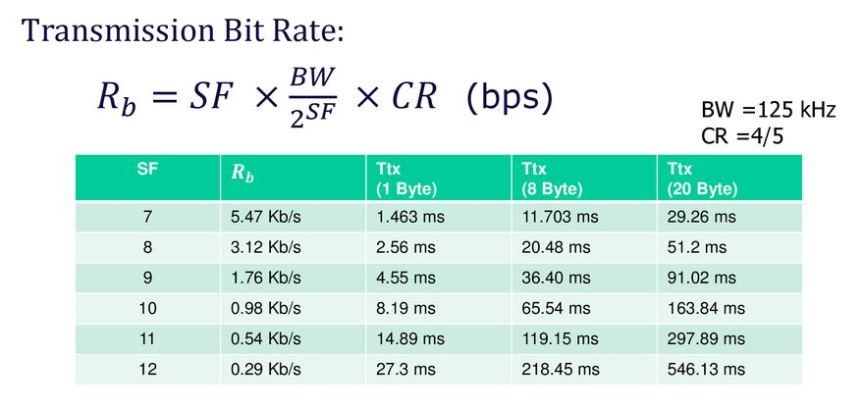


Slide 55
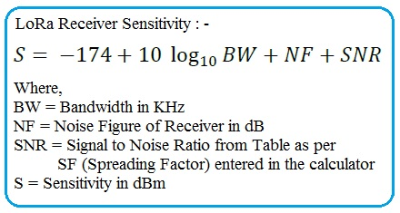

Slide 56
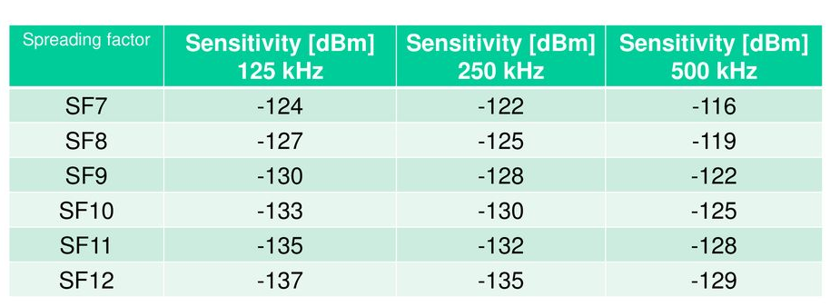

Slide 57
























Background: LoRa and LoRaWAN
$$SF=?, PT=?$$
$$SF=?, PT=?$$
$$(x,y)$$
Determination of power and spread factor With the goal:
Interference is fair
Increase delivery ratio
Increase delivery ratio in noisy channel
$$(x,y)$$
$$d_{2}$$
$$d_{6}$$
$$(X_{2},Y_{2})$$
$$(x,y)$$
$$(x,y)$$
$$d_{4}$$
$$d_{3}$$
$$SF=7, PT=2$$
$$SF=12, PT=14$$
$$d_{5}$$
$$(x,y)$$
$$d_{1}$$
$$d_{7}$$
$$(x,y)$$
$$SF=?, PT=?$$
$$(x,y)$$
$$SF=?, PT=?$$
$$SF=?, PT=?$$

